Slide 1


Slide 2


Slide 3
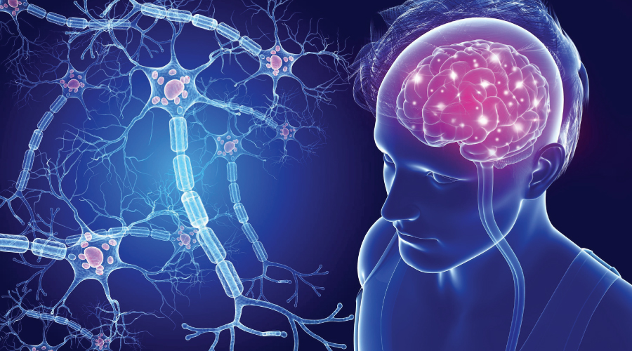

Slide 4
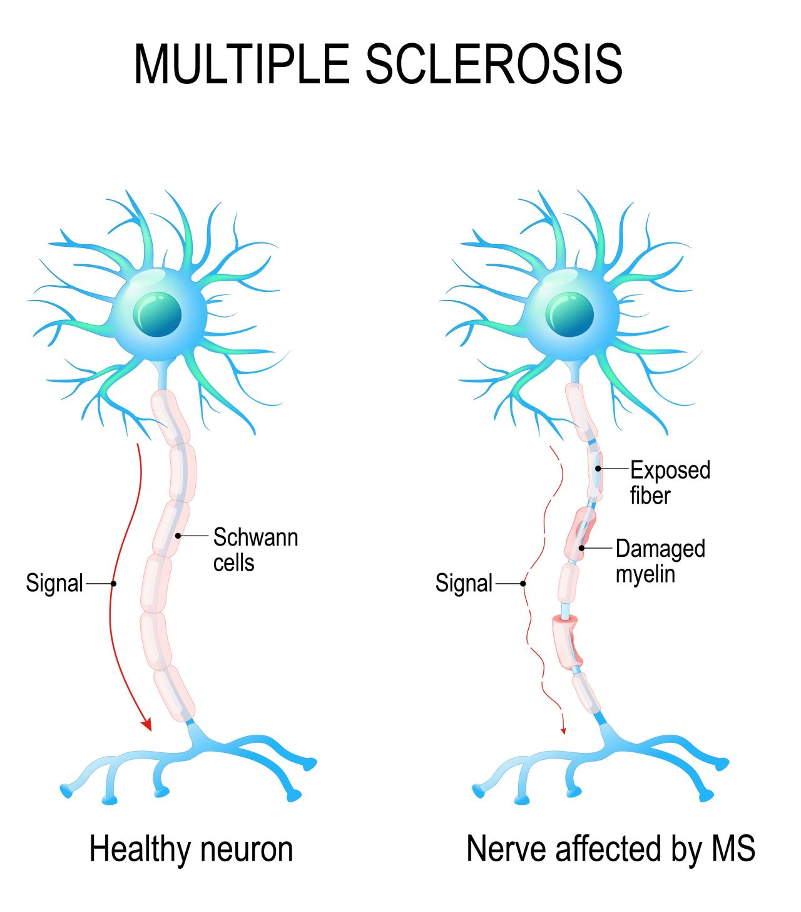
Prepared by:
Bandana Tiwari
Roll no: 6
BNS 2nd year

Slide 5
GENERAL OBJECTIVES
At the end of the classroom session, BNS 1st year students will be able to explain about Multiple sclerosis and Parkinson’s Disease .

Slide 6
SPECIFIC OBJECTIVES
At the end of this teaching session, the BNS 1st year students will be able to :
define multiple sclerosis
state the types of multiple sclerosis
list the risk factors of multiple sclerosis
explain the pathophysiology of multiple sclerosis

Slide 7
state the signs and symptoms of multiple sclerosis
enlist the diagnostic investigation of multiple sclerosis
explain the treatment procedure of multiple sclerosis
explain the nursing management of multiple sclerosis
explain the prevention of multiple sclerosis
define Parkinson’s disease
list the risk factors of Parkinson’s disease
explain the pathophysiology of Parkinson’s disease

Slide 8
state the signs and symptoms of Parkinson’s disease
list the stage of Parkinson’s disease
enlist the diagnostic investigation of Parkinson’s disease
explain the treatment procedure of Parkinson’s disease
explain the nursing management of Parkinson’s disease

Slide 9
Common Neurological Problems of Older Adults
Multiple sclerosis
Parkinson’s Disease
Stroke

Slide 10

Multiple Sclerosis

Slide 11
INTRODUCTION
Multiple sclerosis (MS), also known as disseminated sclerosis or encephalomyelitis disseminate.
Multiple sclerosis is defined as an autoimmune disease that affects the CNS and is characterized by the loss and /or damage of the myelin sheath.

Slide 12
It is a inflammatory disease in which the insulating covers of the nerve cells, in the brain and spinal cord are damaged
Damaged cell disrupts the ability of part of nervous system to communicate.
Its developed wide range of sign and symptoms including physical, mental and sometimes psychiatric problems.

Slide 13
TYPES
Relapsing /Remitting multiple sclerosis (RRMS)
Relapsing Multiple sclerosis is characterized by period of flare- ups and remission.
Primary progressive multiple sclerosis (PPMS)
This type of multiple sclerosis is usually slow continuous, periodically progressive and results in worsening of disease in a period of time .

Slide 14
Secondary progressive multiple sclerosis (SPMS)
This type is initially diagnosed and disappear but relapse in over a time period (approximately within 10 years) and then becomes steady and disease worsening develops.
Progressive relapsing multiple sclerosis (PRMS)
This type of multiple sclerosis has a steady worsening pattern with acute relapse.

Slide 15
RISK FACTORS
Age
Sex
Family history
Smoking
Infection

Slide 16
PATHOPHYSIOLOGY
Due to various contributing factors
Result in the loss of myelin, disappearance of oligodendrocytes and proliferative astrocytes
Initially myelin sheath of the neurons in the brain and spinal cord are interfered but nerve fibers are not affected

Slide 17
Changes in the myelin results in plaque formation which will be scattered throughout the CNS
Loss of myelin results in the noticeable impairment of function
With the destruction of axon in late stage impulses are totally blocked
Result in permanent loss of nerve function

Slide 18
SIGN AND SYMPTOMS
Motor Manifestations
Weakness or paralysis of limbs, trunk and head
Diplopia
Scanning speech
Spasticity of muscle

Slide 19
Sensory Manifestation
Numbness and tingling
Blurred vision
Vertigo and tinnitus
Decrease hearing
Chronic neuropathic pain

Slide 20
Cerebellar Manifestations
Nystagmus
Ataxia
Dysphagia
Emotional Manifestation
Anger
Depression

Slide 21
DIAGNOSTIC INVESTIGATION
History Taking
Neurological Examination
Blood test
Magnetic resonance imaging
Evoke potential test

Slide 22
Cont..
Cerebrospinal fluid (CSF) analysis

Slide 23
TREATMENT
Corticosteroids
Plasma exchange (plasmapheresis)
Treatment for sign and symptoms
Immunosuppressive therapy

Slide 24
Cont…
Nutritional therapy
Antispasmodic

Slide 25

NURSING MANAGEMENT

Slide 26
NURSING MANAGEMENT
ASSESSMENT
Assess the condition of the patient
Monitor vital sign of the patient
Assess the cognitive ability of the patient
Assess the level of knowledge

Slide 27
NURSING DIAGNOSIS
Acute pain related to actual/ potential damage
Disturbed sensory perception related to disease condition
Impaired physical mobility related to weakness/ spasticity/ataxia
Deficit knowledge related to disease condition

Slide 28
NURSING INTERVENTION
RELIEF PAIN
Divert the mind of the patient by recreational activity.
Provide bed rest
Provide comfortable position
Provide analgesic as per physician order
Provide emotional support to the patient

Slide 29
SENSORY PERCEPTION
Maintain interpersonal relationship with patient
Provide comfortable environment
Allow the patient to share his/her experience (hallucination, delusion)
Provide familiar object or persons
Place harmful object away from the elderly

Slide 30
MAINTAIN PHYSICAL MOBILITY
Encourage the patient to perform physical activity, if the patient can perform
Stretch muscle and perform range of motion exercise
Provide knowledge regarding exercise to the visitors
Encourage patient to maintain upright and erect posture
Administer anti- spasmodics as ordered

Slide 31
URINARY CONTINANCE
Assess the skin for incontinence associated dermatitis
Maintain fluid intake of 2000 ml/day
Change diaper frequently to prevent friction
Catheterized the patient if needed
Provide incontinence care such as massaging, changing position

Slide 32
Knowledge
Establish rapport with patient and family member.
Assess client ability, readiness, barriers to learning .
Explain to client and family member about the disease process with the clear and understandable explanation.
Educated the client and the family about the treatment regiment that the patient will .

Slide 33
Provide psychological support
Provide health teaching regarding health promotion activity

Slide 34
PREVENTION
Nutritional changes
Eliminating food allergens
Avoiding refined foods and adding supplements
Exercise also important

Slide 35
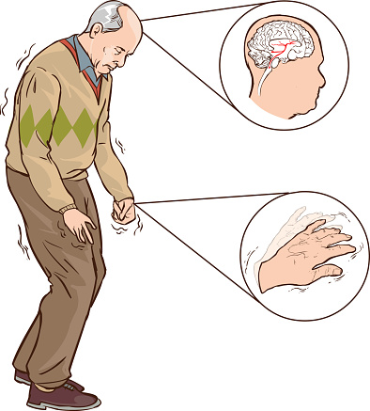

Slide 36

Parkinson’s disease

Slide 37
INTRODUCTION
Parkinson’s disease is slowly progressing neurologic movement disorder that eventually leads to disability .
It is a second most common neurodegenerative disorder after Alzheimer’s disease.
The prevalence is about 0.3% of the whole population in industrialized countries.

Slide 38
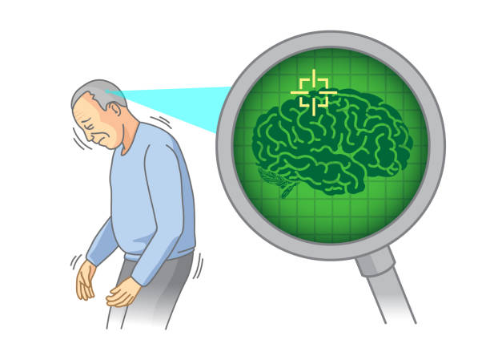
It is more common in the older adults and prevalence rises from 1% in those over 60 years of age to 4% of the population over 80.

Slide 39
RISK FACTORS
Idiopathic
Aging
Genetic
Drug induced
Head trauma

Slide 40
PATHOPHYSIOLOGY
Decreased level of dopamine due to destruction of pigmented neuronal cells in the Substantia Nigra in the basal ganglia of brain
Depletion of dopamine store
Degeneration of the dopaminergic nigrostraiatal pathway
Imbalance of excitatory and inhibiting neurotransmitters

Slide 41
Impairment of extrapyramidal tract controlling complex body movement
Manifest symptoms like : tremor, rigidity , bradykinesia

Slide 42
SIGN AND SYMPTOMS
Cardinal sign
Tremor
Rigidity
Akinesia / Bradykinesia
Postural imbalance

Slide 43
Others
Mask like appearance
Orthostatic hypotension
Depression
Constipation
Sleep disorders
Drooling

Slide 44
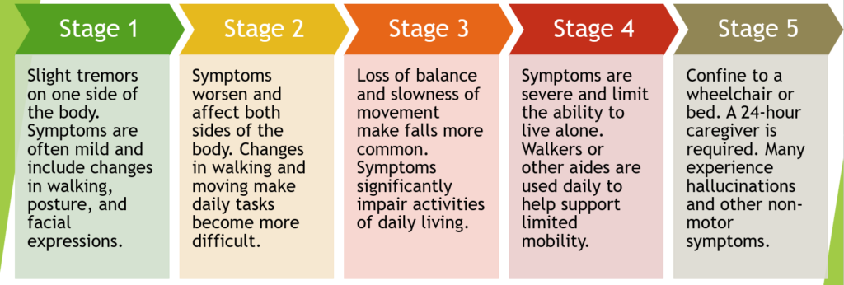
STAGES OF PARKINSON’S DISEASE

Slide 45
DIAGNOSTIC INVESTIGATION
History taking
Neurological examination
Drug challenge test

Slide 46
Test for depression and dementia
MRI (Magnetic resonance imaging)
CT- Scan (Computed tomography scan )
PET- Scan ( Positron emission tomography scan )

Slide 47
TREATMENT
Pharmacological therapy:
Anti- histamines , Tri-cyclic antidepressants, Anti- viral agent , levodopa (choice of drug )
Neural transplantation
Deep brain stimulation

Slide 48
NURSING MANAGEMENT
Assessment
Assess the condition of the patient.
Assess the patient’s gait , posture.
Monitor vital sign of the patient.
Assess the patient knowledge regarding disease condition.

Slide 49
NURSING DIAGNOSIS
Impaired physical mobility related to bradykinesia .
Assist the patient in active or passive range of motion exercise.
Provide adequate nutrition.
Provide bed rest.
Promote and facilitate ambulation techniques.

Slide 50
Impaired bowel elimination related to decreased activity
Monitor intake and output of the patient.
Monitor bowel sound.
Provide fibrous rich diet.

Slide 51
Cont..
Encourage patient to have plenty of fluid.
Encourage patient for exercise and activity.
Provide enema as per physician order.

Slide 52
Self care deficit related to altered cognitive function
Use consistent routine and allow adequate time.
Encourage patient to self care if he/she can perform.
Give simple and short instruction.
If patient unable to perform self care provide care accordingly.

Slide 53
Sleeping pattern disturbance related to disease condition
Provide calm and quite environment.
Avoid caffeine product at bed time.
Provide same time for bed.

Slide 54
Cont..
Encourage patient to avoid naps during day time.
Avoid excessive light in the bedroom.
Provide sedatives as needed by physician order

Slide 55
Knowledge deficit related to disease condition
Establish rapport with the patient and family member
Assess client ability , readiness, barriers to learning.
Explain to the client and family member about the disease process with the clear, thorough, and understandable explanation.

Slide 56
Cont..
Educate the client and the family about the treatment regimen that the patient will
Provide psychological support.
Provide health teaching regarding health promotion activity.

Slide 57


Slide 58


Slide 59
POST TEST
Fill in blanks
Cardinal sign of Parkinson’s disease…
Mask like appearance
Drooling
c) Postural imbalance
d) Sleep disorder

Slide 60
True or false
Dopamine level increased in Parkinson’s disease..
( False )
There are four types of multiple sclerosis..
( True )

Slide 61
ASSIGNMENT
1) What do you understand about Parkinson’s disease? Write the cardinal signs and nursing management of it.
2) Write short note on:
Multiple sclerosis

Slide 62
PLAN FOR NEXT CLASS
We will discuss about age related changes in endocrine system and Hyperthyroidism .

Slide 63
REFERENCES
Baral, R. Essential of Geriatric Nursing. Makalu publication.
Bruners and Siddharth, Medical Surgical Nursing, 10th edition.
Pradhan , M,K and Roka, A,T. (2015). Gerontological Nursing for BN/BSN Students (1st edition) Vidyarthi Prakashan.

Slide 64
Subedi, P,S and Subba, K,H.(2019). A Textbook of Geriatric Nursing.(1st edition ). National Book Center.
Timalsina, R. (2077). Comprehensive Textbook of Geriatric Nursing.(3rd ed). Samiksha publication.

Slide 65


